Slide 1
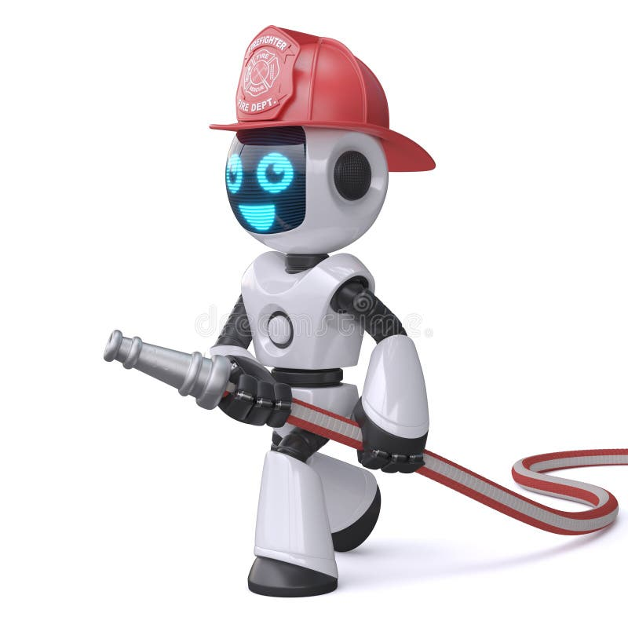
Fire Fighting Robot
Presented By:
Mahmoud Esmat Abdallah Fahmy
Supervised by:
Dr. El-Shimaa Nabil
Muhammed Ayman Muhammed Fathy
Mahmoud Ashraf Fathy Abdel-all
Salma Osama Mohamed Abdel-hay
Omnia Wael Ibrahim Abdel-azim
Amira Ayman Refaat Mohamed
Aya Khaled Goda Mohamed Sanad
Mai Mohamed Naguib Mohamed
Rehab Alaa Atea Mohamed

Slide 2
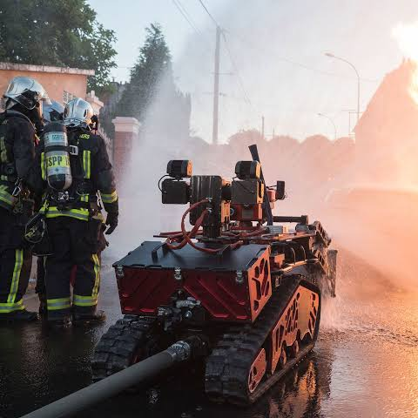
Content
Abstract
Literature review
Analysis
Design & Implementation
Debugging-Test-run
Result
Demo
Conclusion and Future Improvements
Bibliography

Slide 3






Abstract
Literature
Analysis
Design
Test-run
Result
Idea
Design and implementation of a smart fire-fighting car based on IoT and AI technologies. The system can detect fires, identify their type and cause, choose the appropriate extinguishing method (water, foam, or CO2), and autonomously move to the fire location to extinguish it.
Motivation
Delays in human response increase the danger and damage caused by fires. Therefore, there is a need for an intelligent and fast-response solution that uses modern technologies to minimize losses and provide immediate and effective action in emergency situations.

Slide 4
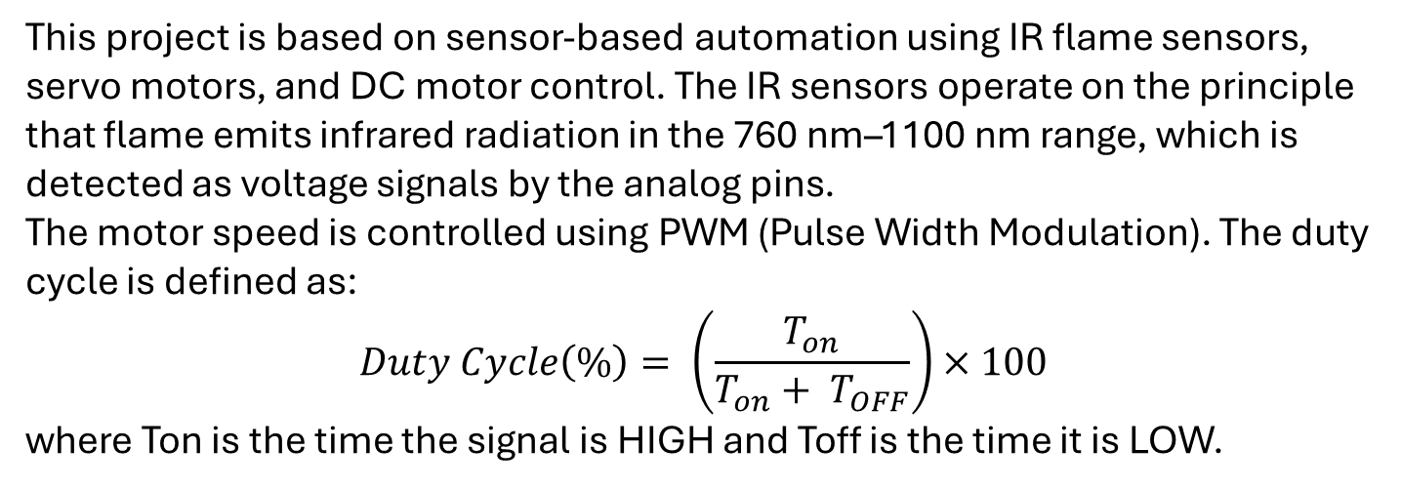
Abstract
Literature
Analysis
Design
Test-run
Result
Theory
This project is based on sensor-based automation using IR flame sensors, servo motors, and DC motor control. The IR sensors operate on the principle that flame emits infrared radiation in the 760 nm–1100 nm range, which is detected as voltage signals by the analog pins.
The motor speed is controlled using PWM (Pulse Width Modulation). The duty cycle is defined as:
$$Duty Cycle\left(\%\right)= \left(\frac{T_{on}}{T_{on}+ T_{OFF}}\right)×100$$
where Ton is the time the signal is HIGH and Toff is the time it is LOW.

Slide 5
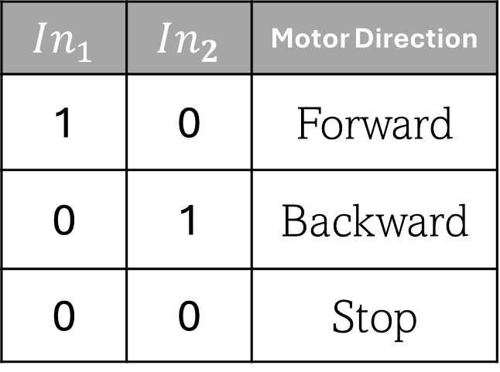
Abstract
Literature
Analysis
Design
Test-run
Result
Theory
The servo motor controls the pump tube to move to a specific angle between 0° to 180° .
The L298N motor driver follows H-Bridge logic to control the direction of the motor based on the input signals:
$$In_{1}$$ | $$In_{2}$$ | Motor Direction
1 | 0 | Forward
0 | 1 | Backward
0 | 0 | Stop

Slide 6
Abstract
Literature
Analysis
Design
Test-run
Result
Paper No. | Abstract | Functionality | Advantages | Limitations | Testing & Results
1 | IoT-based autonomous robot for indoor fire detection and suppression using ESP32 microcontroller. | Detects fire using flame/smoke sensors, activates water pump, and can be controlled remotely via Blynk app. | Remote control, cost-effective, autonomous operation, IoT integration for real-time monitoring. | Struggles in highly cluttered environments, water pump capacity limits fire suppression. | Tested in controlled environments; effective fire detection, navigation, and suppression.
2 | Microcontroller-based system with GSM communication for early fire detection and suppression. | Monitors temperature, smoke, and flame; sends SMS alerts via GSM; activates firefighting pump. | Early fire detection, wireless communication via GSM, visual feedback via LED panel. | Limited by GSM network coverage, it may not work in areas with poor signal. | Tested for sensor accuracy, GSM communication, and pump activation; satisfactory results.

Slide 7
Abstract
Literature
Analysis
Design
Test-run
Result
Paper No. | Abstract | Functionality | Advantages | Limitations | Testing & Results
3 | Autonomous robot with flame and IR sensors for fire detection and extinguishing. | Detect fire using flame sensors, navigates using IR sensors, and extinguish fire. | Compact design, autonomous fire detection, remote monitoring via camera, lightweight. | Limited range of flame sensors may struggle in large or highly obstructed areas. | Tested for fire detection and extinguishing; successful in small, controlled environments.
4 | A firefighting robot designed to detect and extinguish fires autonomously using IoT technology, equipped with sensors, AI, and a water pump. | Detects fire using IR flame sensors, navigates autonomously, and extinguishes fires using a submersible water pump. | Reduces human risk, operates in hazardous environments, real-time fire detection, and autonomous navigation. | Struggles in large or highly obstructed areas, limited water pump capacity, and reliance on battery power. | Successfully tested in controlled environments; effectively detects and extinguishes small fires.

Slide 8
Abstract
Literature
Analysis
Design
Test-run
Result
Paper No. | Abstract | Functionality | Advantages | Limitations | Testing & Results
5 | A firefighting robot controlled via PC, using Bluetooth for wireless control, with both automated and manual modes. | Detects fire using IR sensing, controlled wirelessly via Bluetooth, and extinguishes fires using a 3-axis fire hose. | High efficiency (95%), operates in both automated and manual modes, reduces human risk in firefighting. | Limited by Bluetooth range, EMI interference from motors, and reliance on operator skill in manual mode. | Automated mode is faster in extinguishing fires, but manual mode is more reliable in complex situations.

Slide 9
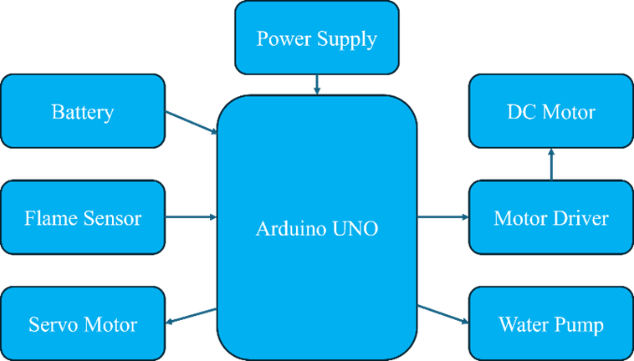
Abstract
Literature
Analysis
Design
Test-run
Result
Block Diagram

Slide 10
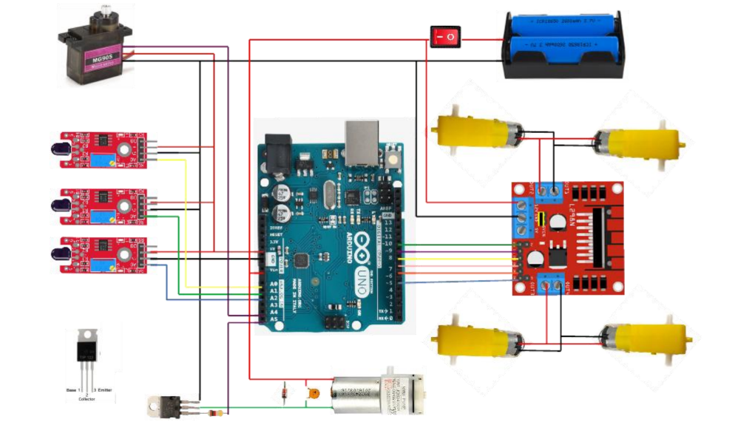
Abstract
Literature
Analysis
Design
Test-run
Result
Circuit Diagram

Slide 11
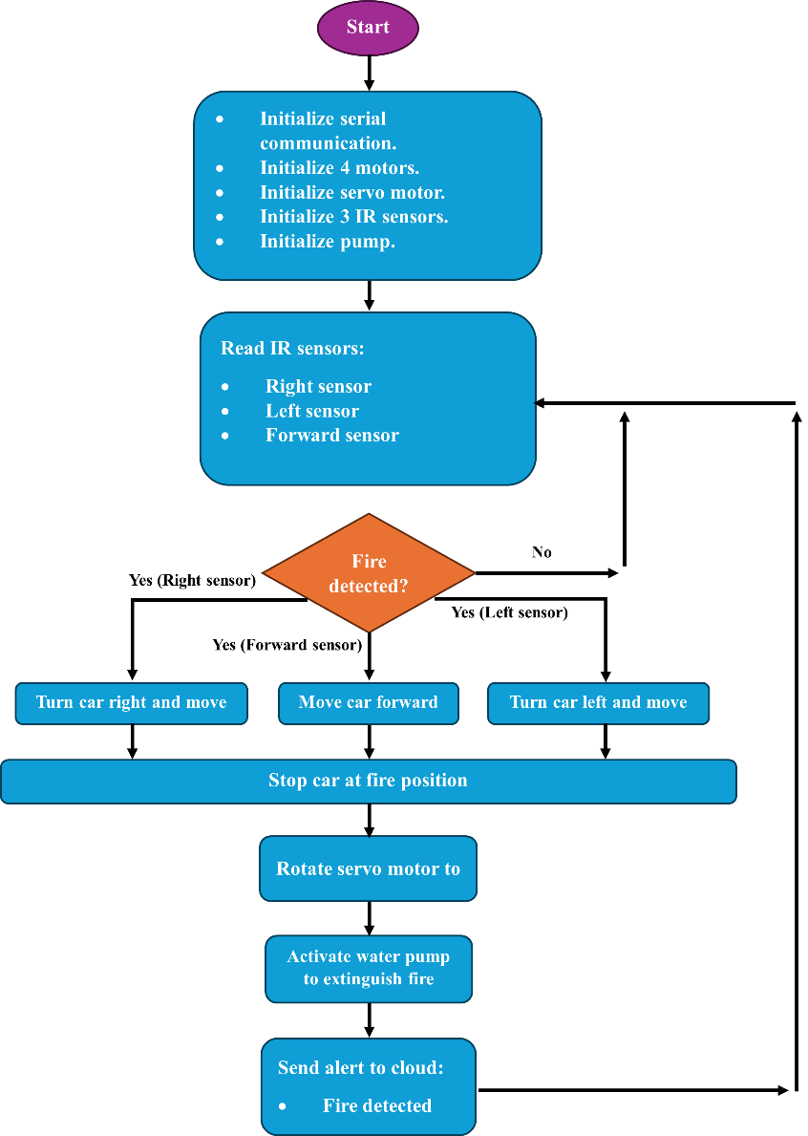
FlowChart

Slide 12
Abstract
Literature
Analysis
Design
Test-run
Result
Functional modules of code
Motion Control Module
Functions such as forward(), backward(), turnRight(), turnLeft() and stop().
Sensor Reading Module
Values are read using analogRead() and stored in variables.
Servo Control Module
The servoPulse() Sends a pulse to the servo to move to a specific angle
Pump Control Module

Slide 13
Hierarchical Relationship
setup() initializes pin modes and performs an initial sweep using the servo.
loop() serves as the central controller, invoking motion or fire handling routines based on sensor data.
Supporting functions (like movement and servo control) are modular and reusable, keeping the code organized and scalable.

Slide 14

Code Documentation
Inline comments throughout the code explain pin functions, logic for movement, sensor reading, and fire handling.
Function names are self-explanatory and modular, improving code readability.
GitHub Link: Firefighting Robot

Slide 15
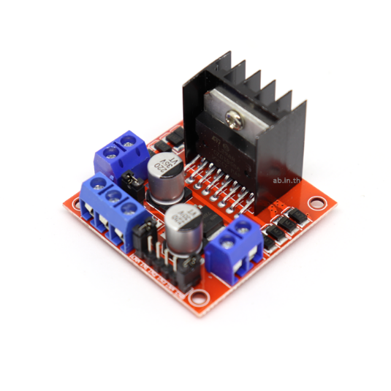
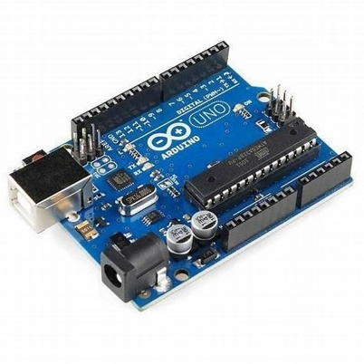
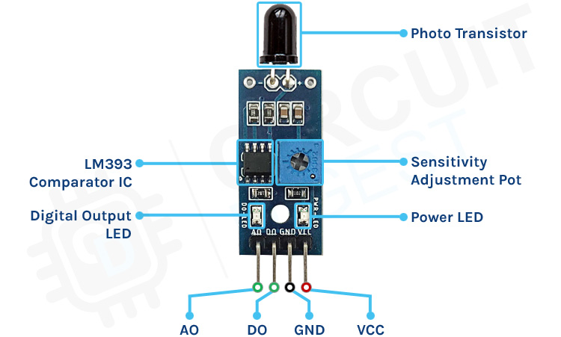
System Requirements
Microcontroller. Arduino Uno or compatible board
Motor Driver: L298N Dual H-Bridge
Sensors: IR flame sensors (connected to analog pins A0, A1, A2)
Actuators:
Servo motor (connected to A4)
Water pump (controlled via pin A5)
Power Supply: 5V to 12V regulated (for motors and pump)

Slide 16
System Requirements
Development Tools:
Arduino IDE
USB Cable for uploading code
Operating System: Windows/Linux/macOS with Arduino IDE installed
Libraries Used: servo.h

Slide 17
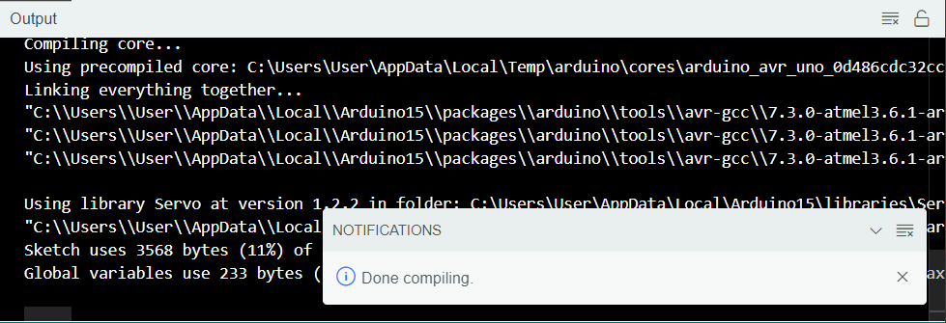
Abstract
Literature
Analysis
Design
Test-run
Result
Software Testing
Code Compiling

Slide 18

Simulation in Proteus
Before implementing the hardware, the entire system was simulated in Proteus 8 Professional to test the circuit and logic. The simulation setup included:
Arduino Uno with pre-loaded code
IR sensors feeding analog signals
Virtual DC motors and servo
Digital representation of the pump (e.g., motor)
This simulation allowed verification of:
Accurate sensor response
Correct motor behavior (forward, backward, turning)
Smooth servo sweep for water targeting
Reliable activation of the pump upon fire detection

Slide 19
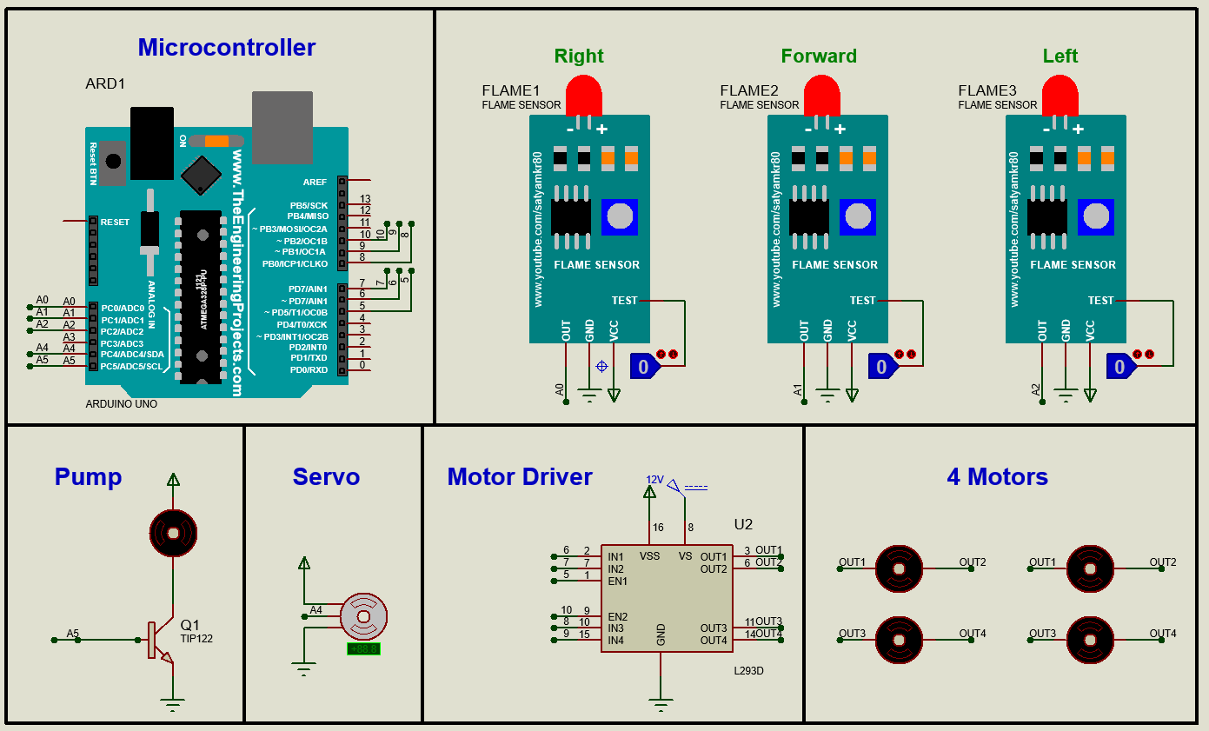
Simulation and Testing
Module Testing: We tested each module separately to make sure every component works properly before integrating them together.
Logic Validation: After integrating all modules, we performed logic validation to ensure the robot behaves correctly in each scenario.

Slide 20
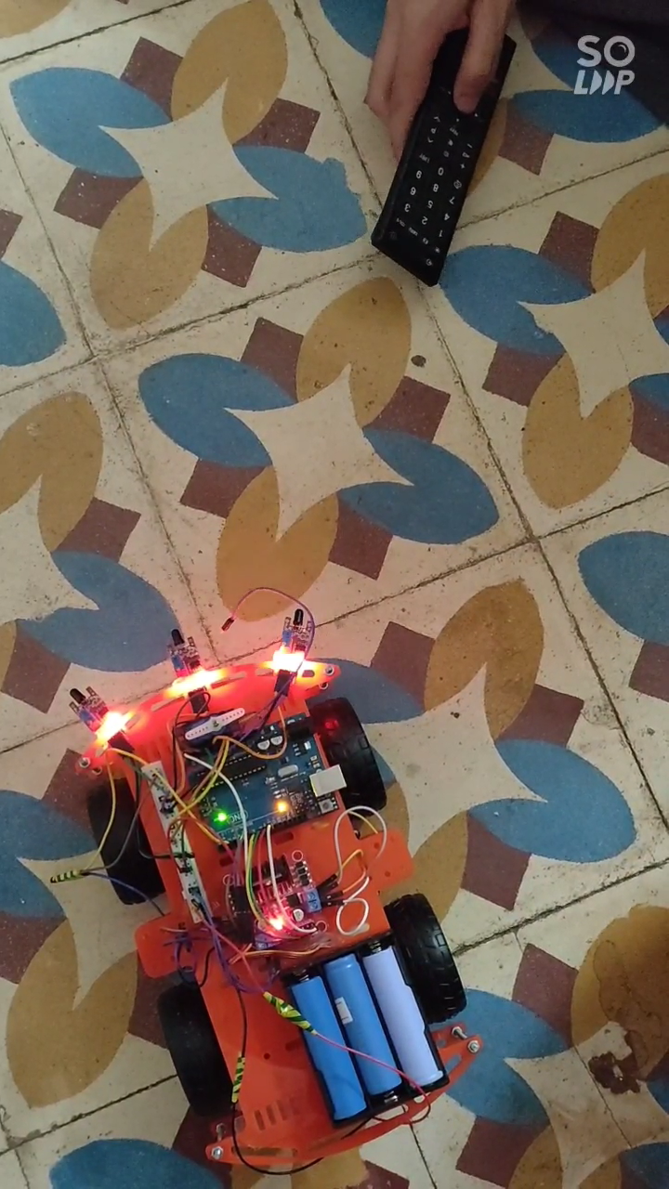
Abstract
Literature
Analysis
Design
Test-run
Result
Hardware result

Slide 21
Conclusion
The project successfully demonstrates the design and implementation of an autonomous fire-fighting robot capable of detecting and extinguishing fires in real time.
The system utilizes IR flame sensors to detect fire and Arduino-based control to process sensor data and operate motors and pumps.
suitable for small-scale fire safety solutions where human presence is risky or limited.
Overall, this work contributes meaningfully toward smart emergency response systems, promoting safer and faster action during fire-related incidents.
Application: Industrial warehouses, smart homes, and disaster zones.

Slide 22



Future Improvements
Obstacle Avoidance by adding ultrasonic or LiDAR sensors.
Replacing IR sensors with higher-range thermal sensors would improve fire detection capabilities.
Enhancing the AI model with more training data could improve classification accuracy for different types of fire sources and indicate the appropriate extinguishing method, whether water or CO₂.

Slide 23
Bibliography
S. Ramasubramanian et al., "Autonomous Firefighting Robot Using Arduino and Flame Sensors," IEEE Int. Conf. Comput. Intell. Data Sci., 2020.
R. Arabelli, "Design and Implementation of a Firefighting Robot Using IoT and AI," Int. J. Sci. Res. Sci. Eng. Technol., 2020.
N. M. S. et al., "Fire Detection and Suppression Using IoT and Machine Learning," Int. J. Adv. Res. Comput. Commun. Eng., 2016.
T. Rakib et al., "Development of a Firefighting Robot with Obstacle Avoidance Capabilities," Int. Conf. Informatics, Electronics & Vision (ICIEV), 2016.
S. J. Priyanka et al., "Android-Controlled Firefighting Robot Using Bluetooth Technology," Int. J. Innov. Sci. Eng. Technol., 2017.

Slide 24

If you have any questions, ask eagles team 😎
Link of Video: YouTube Video Link
Thanks

